Slide 1

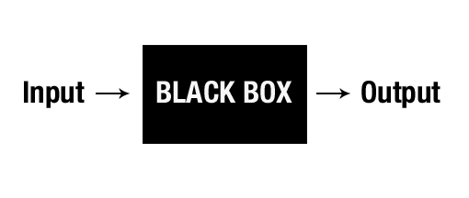
Understanding neural networks
for automatic channel detection

Slide 2
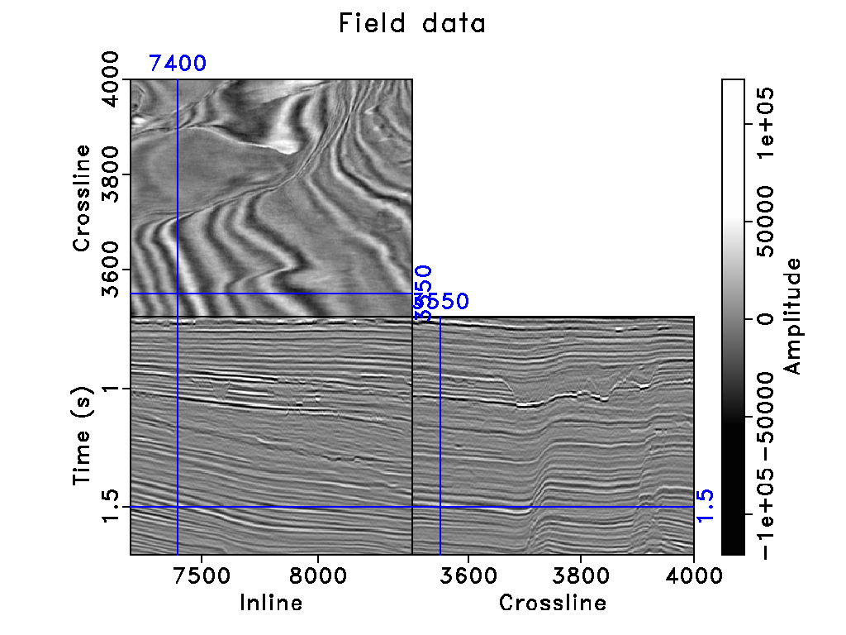
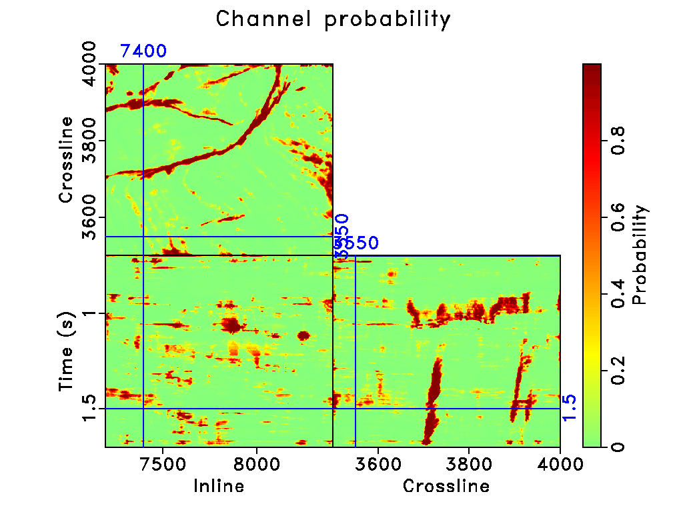
Motivation
f
Box (1976): “All models are wrong but some are useful.”

Slide 3
Model Uncertainty

Slide 4
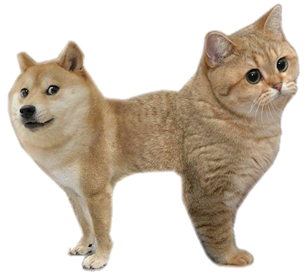

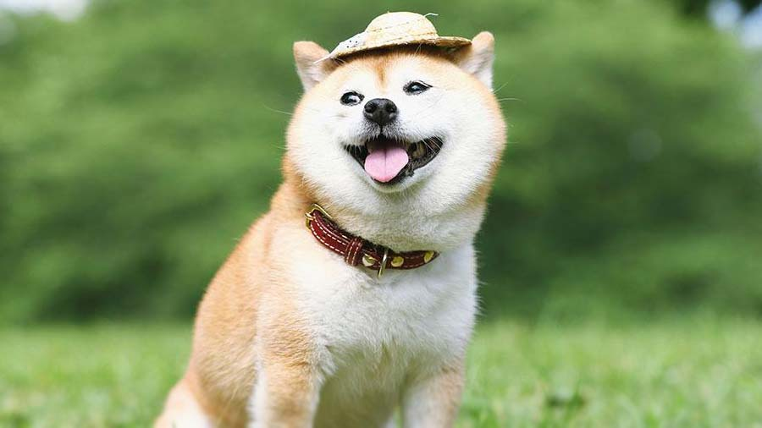
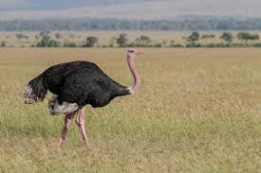
Notes:
This is because the standard model would pass the predictive mean through the softmax rather than the entire distribution.
Note: In a classification problem, the softmax output gives you a probability value for each class, but this is not the same as uncertainty. The softmax probability is the probability that an input is a given class relative to the other classes. Because the probability is relative to the other classes, it does not help explain the model’s overall confidence.
The softmax func-tion approximates relative probabilities between the classlabels, but not an overall measure of the model’s uncertainty

Slide 5
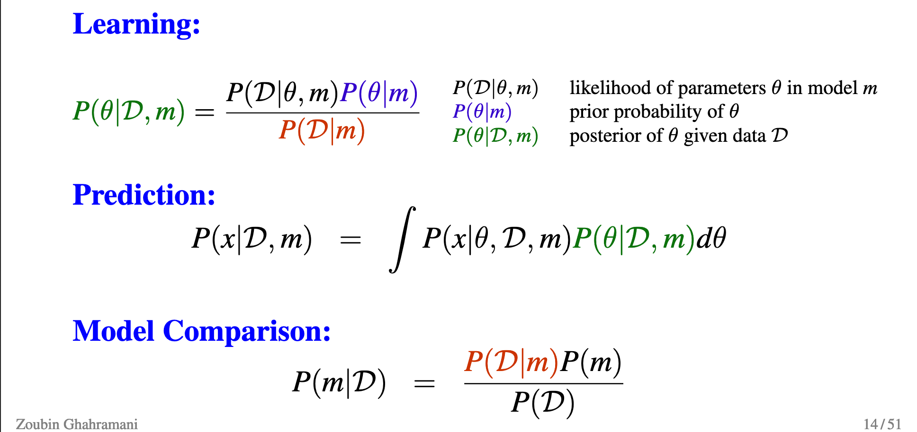
Bayesian neural networks
Ghahramani (2017)
Uncertainty comes from all sources of parameter uncertainty, structure uncertainty, noise in data ...
Notes:
Normal NN is a MAP

Slide 6

Aleatoric uncertainty
What can’t be understood from the data. A function of input data.
Can be explained away with the ability to observe all explanatory variables with increased precision.
https://www.wired.com/story/tesla-autopilot-self-driving-crash-california/
Notes:
Changing noise
In non-Bayesian neural networks, this observation noise pa-rameter is often fixed as part of the model’s weight decay, and ignored,
Data properties.
Unsupervised
aleatoric uncertainty played a role in the first fatality involving a self driving car
Tesla has said that during this incident, the car's autopilot failed to recognize the white truck against a bright sky
In the case of the Tesla incident, although the car's radar could "see" the truck, the radar data was inconsistent with the image classifier data and the car's path planner ultimately ignored the radar data (radar data is known to be noisy). If the image classifier had included a high uncertainty with its prediction, the path planner would have known to ignore the image classifier prediction and use the radar data instead (this is oversimplified but is effectively what would happen. See Kalman filters below).

Slide 7
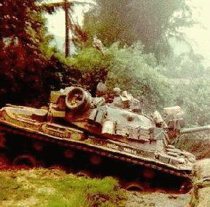
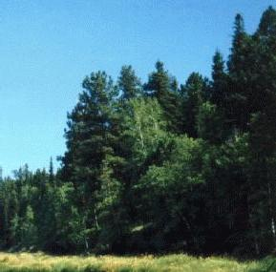
Epistemic uncertainty
https://neil.fraser.name/writing/tank/
Model parameter uncertainty.
Can be explained away given enough data.
Notes:
Model properties.
In the 1980s, the Pentagon wanted to harness computer technology to make their tanks harder to attack.
The preliminary plan was to fit each tank with a digital camera hooked up to a computer. The computer would continually scan the environment outside for possible threats (such as an enemy tank hiding behind a tree), and alert the tank crew to anything suspicious. Computers are really good at doing repetitive tasks without taking a break, but they are generally bad at interpreting images. The only possible way to solve the problem was to employ a neural network.
The research team went out and took 100 photographs of tanks hiding behind trees, and then took 100 photographs of trees - with no tanks. They took half the photos from each group and put them in a vault for safe-keeping, then scanned the other half into their mainframe computer. The huge neural network was fed each photo one at a time and asked if there was a tank hiding behind the trees. Of course at the beginning its answers were completely random since the network didn't know what was going on or what it was supposed to do. But each time it was fed a photo and it generated an answer, the scientists told it if it was right or wrong. If it was wrong it would randomly change the weightings in its network until it gave the correct answer. Over time it got better and better until eventually it was getting each photo correct. It could correctly determine if there was a tank hiding behind the trees in any one of the photos.
But the scientists were worried: had it actually found a way to recognize if there was a tank in the photo, or had it merely memorized which photos had tanks and which did not? This is a big problem with neural networks, after they have been trained you have no idea how they arrive at their answers, they just do. The question was did it understand the concept of tanks vs. no tanks, or had it merely memorized the answers? So the scientists took out the photos they had been keeping in the vault and fed them through the computer. The computer had never seen these photos before -- this would be the big test. To their immense relief the neural net correctly identified each photo as either having a tank or not having one.
The Pentagon was very pleased with this, but a little bit suspicious. They commissioned another set of photos (half with tanks and half without) and scanned them into the computer and through the neural network. The results were completely random. For a long time nobody could figure out why. After all nobody understood how the neural had trained itself.
Eventually someone noticed that in the original set of 200 photos, all the images with tanks had been taken on a cloudy day while all the images without tanks had been taken on a sunny day. The neural network had been asked to separate the two groups of photos and it had chosen the most obvious way to do it - not by looking for a camouflaged tank hiding behind a tree, but merely by looking at the colour of the sky. The military was now the proud owner of a multi-million dollar mainframe computer that could tell you if it was sunny or not.

Slide 8
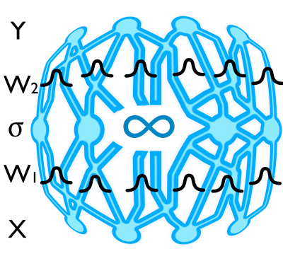
Bayesian deep learning
Including uncertainty in deep learning model predictions (Denker et al. 1991).
Placing a prior distribution over each weight and bias parameter.
Placing a distribution over the output of the model.

Slide 9
Langevin Dynamics
Neal 1993
Desirable for smaller dimensional problems.
Computational expensive.

Slide 10
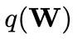
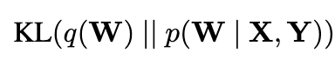
Variational inference
Gal et al. 2016
Notes:
Harder. Number of parameters increase
Variational inference
M: variational parameters
Variational inference
In these approximate inference techniques, the posteriorp(W|X,Y)is fitted with a simple distributionq∗θ(W), parame-terised byθ. This replaces the intractable problem of averaging over all weights in the BNN with anoptimisation task, where we seek to optimise over theparameters of the simple distributioninsteadof optimising the original neural network’s parameters.
Dropout variational inference is a practical approach for approximate inference in large and complexmodels [15]. This inference is done by training a model with dropout before every weight layer,and by also performing dropout at test time to sample from the approximate posterior (stochasticforward passes, referred to as Monte Carlo dropout). More formally, this approach is equivalentto performing approximate variational inference where we find a simple distributionq∗θ(W)in atractable family which minimises the Kullback-Leibler (KL) divergence to the true model posteriorp(W|X,Y).
Here, the approximating variational distributionq(Wi)foreveryK×Kdimensional convolutional layeri, with unitsj, is defined as
The dropout proba-bilities,pi, could be optimised
minimising the cross entropyloss objective function has the effect of minimising theKullback-Leibler divergence term. Therefore training thenetwork with stochastic gradient descent will encourage themodel to learn a distribution of weights which explains thedata well while preventing over-fitting.
Herezi,jare Bernoulli distributed random variables with some probabilitiespi, andMiare varia-tional parameters to be optimised

Slide 11

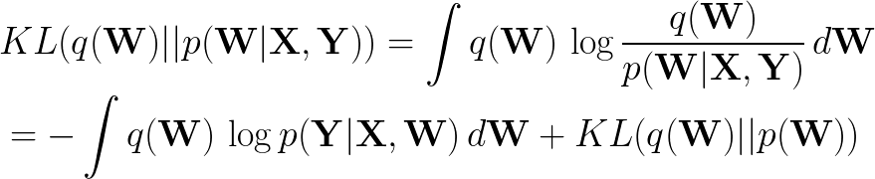
Variational inference
Bishop 2016
Gal et al. 2016
Notes:
Evidence lower bound

Slide 12
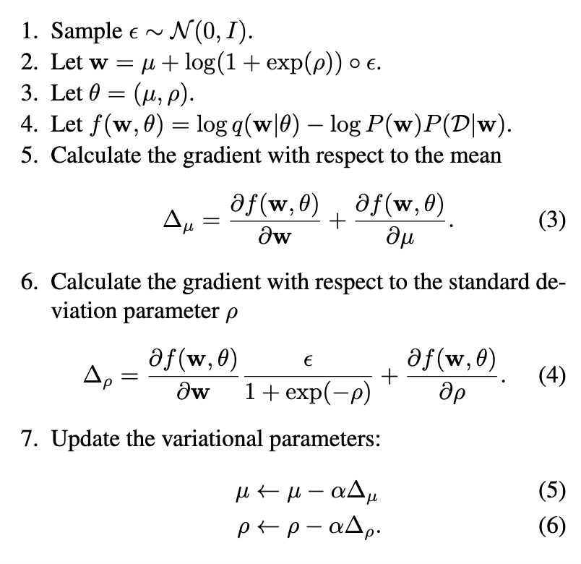
Bayes by backprop
Blundell et al. 2015
Double the number of parameters.

Slide 13
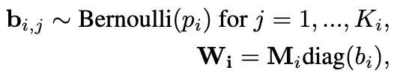
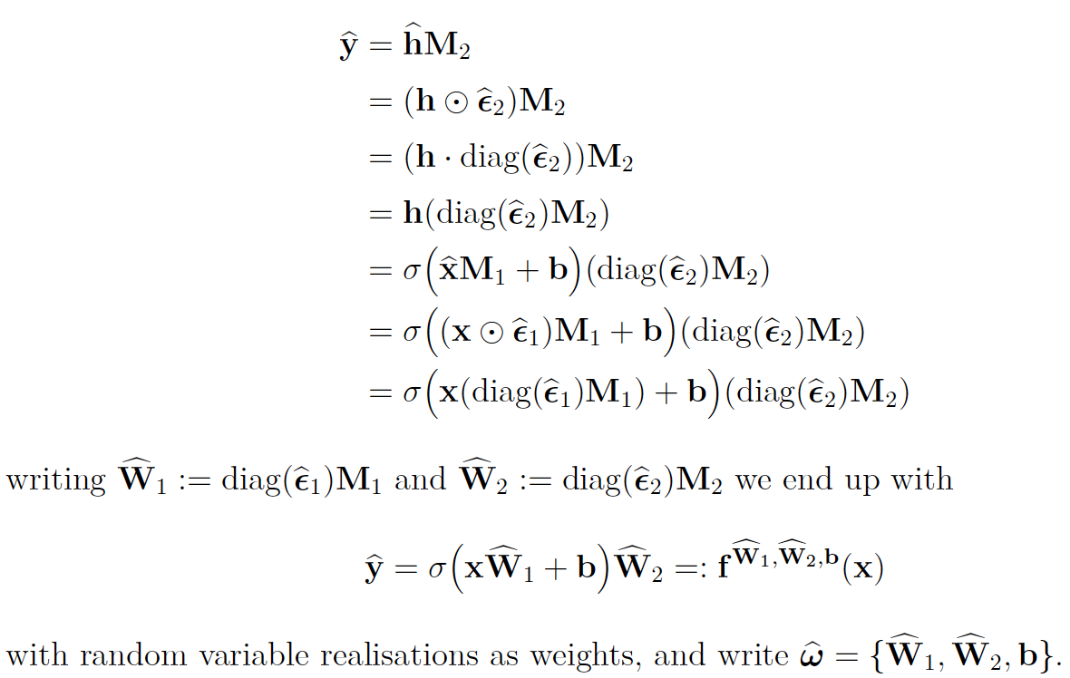
Dropout layer
Gal et al. 2016

Slide 14
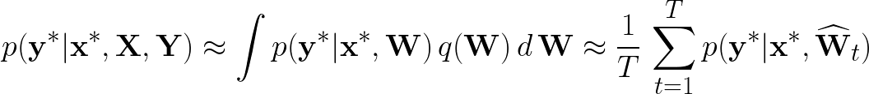
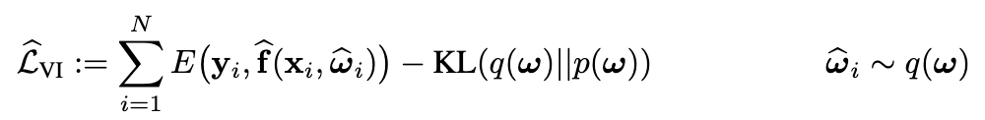
Monte Carlo sampling

Slide 15
Dropout layer
Standard Neural Net.
After applying dropout.
Geoffrey et al. 2014
Dropout randomly removes units within a network. It samples from a number of thinned networks with reduced width.
Dropout can be used at test time to impose a Bernoulli distribution over the filter weights. It can be considered as Monte Carlo samples obtained from the posterior distribution over models.

Slide 16
KL condition
Gal et al. 2016
Assume a normal prior distribution over parameters.
A Bernoulli variational distribution.

Slide 17
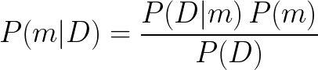
Ensemble methods
Lakshminarayanan et al. 2017
Notes:
Train M models as an ensemble with random initialization
Average
Similar to geology interpreters
the level of approximation is determined byhow well the implicit sampling distributionˆq(θ)approxi-mates the posteriorp(θ|D)

Slide 18
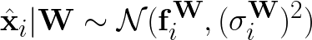
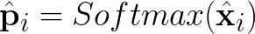
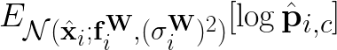
Aleatoric uncertainty
Kendall et al. 2017
Notes:
Sampling the logits -> Does not significantly increase the model test time.
MAP problem
Loss attenuation
HerefWi,σWiare the network outputs with parametersW. This vectorfWiis corrupted with Gaus-sian noise with variance(σWi)2(a diagonal matrix with one element for each logit value), and thecorrupted vector is then squashed with the softmax function to obtainpi, the probability vector forpixeli.
withxi,t,c′thec′element in the logit vectorxi,t.This objective can be interpreted as learning loss attenuation, similarly to the regression case. Wenext assess the ideas above empirically.
withcthe observed class for inputi, which gives us our loss function. Ideally, we would want toanalytically integrate out this Gaussian distribution, but no analytic solution is known. We thereforeapproximate the objective through Monte Carlo integration, and sample unaries through the softmaxfunction. We note that this operation is extremely fast because we perform the computation once(passing inputs through the model to get logits). We only need to sample from the logits, which isa fraction of the network’s compute, and therefore does not significantly increase the model’s testtime. We can rewrite the above and obtain the following numerically-stable stochastic loss:
MonteCarlo integration

Slide 19
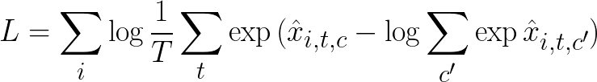
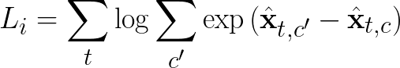
Modified loss function for classification
Kendall et al. 2017
Notes:
MAP inference

Slide 20
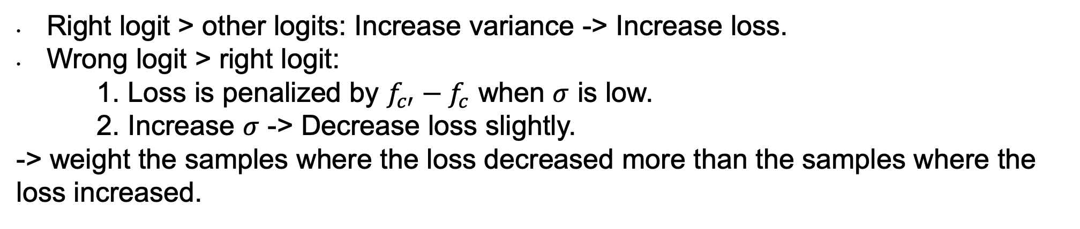
Learned loss attenuation
Right logit > other logits: Increase variance -> Increase loss.
Wrong logit > right logit:
1. Loss is penalized by $f_{c′}−f_{c}$ when $σ$ is low.
2. Increase $σ$ -> Decrease loss slightly.
-> weight the samples where the loss decreased more than the samples where the loss increased.

Slide 21
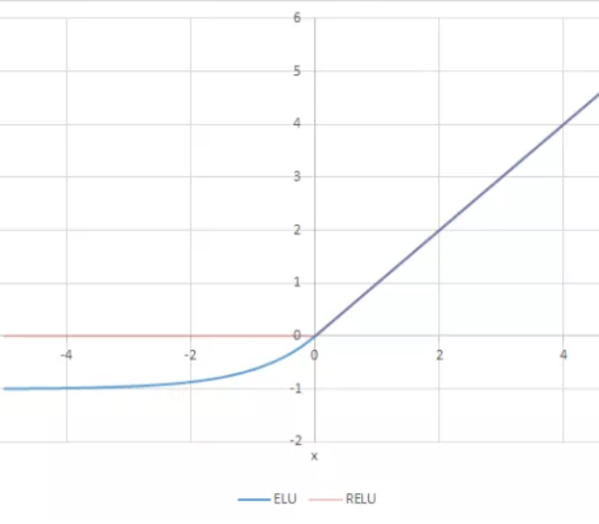
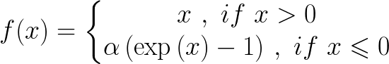
Dorman
Notes:
To make the model easier to train, I wanted to create a more significant loss change as the variance increases. To get a more significant loss change as the variance increases, the loss function needed to weight the Monte Carlo samples where the loss decreased more than the samples where the loss increased.
I applied the elu function to the change in categorical cross entropy, i.e. the original undistorted loss compared to the distorted loss, undistorted_loss - distorted_loss. The elu shifts the mean of the normal distribution away from zero for the left half of Figure 1. The elu is also ~linear for very small values near 0 so the mean for the right half of Figure 1 stays the same.
To ensure the loss is greater than zero, I add the undistorted categorical cross entropy. The ‘distorted average change in loss’ always decreases as the variance increases but the loss function should be minimized for a variance value less than infinity. To ensure the variance that minimizes the loss is less than infinity, I add the exponential of the variance term
variance_loss + undistorted_loss + variance_depressor

Slide 22
Modified loss function for classification
More significant loss change as the variance increases.
The variance is less than infinity.
https://github.com/kyle-dorman/bayesian-neural-network-blogpost

Slide 23
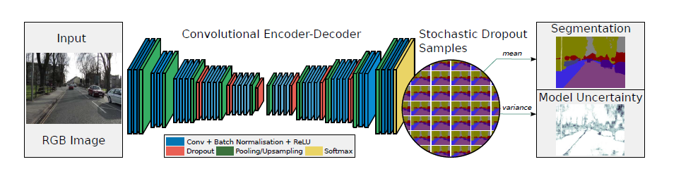
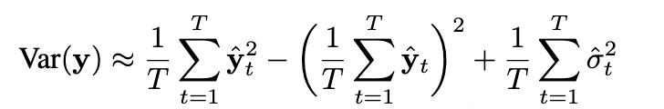
Bayesian encoder-decoder CNN
Kendall et al. 2016

Slide 24
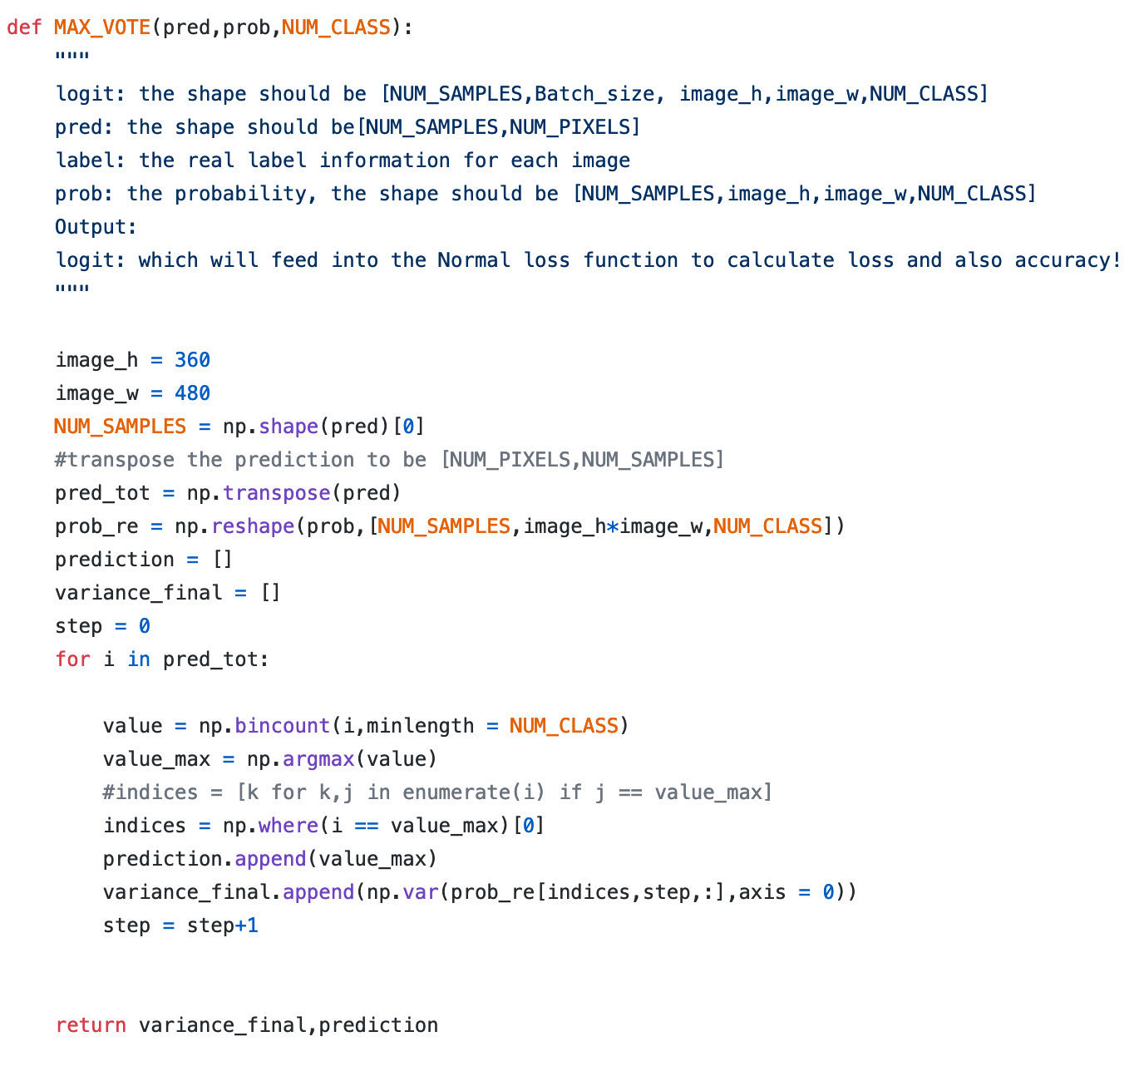
Ensemble learning by max-voting

Slide 25
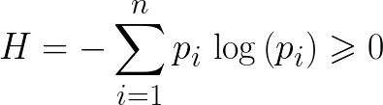
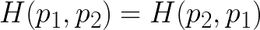
Entropy as uncertainty
Shannon (1948)
Zidek (2003)
Notes:
predictive entropy (the average amount of information contained in the predictive distribution).
- Entropy is a measure of choice, uncertainty and information (Shannon 1948).
- Uncertainty should decrease as the amount of information increases
(Zidek 2003).
Positive
Max uniform prob P=0.5
Additive
Zero
Uniform distributions with more outcomes have more uncertainty
Events with a certain outcome have zero uncertainty
Flipping argument no effect

Slide 26
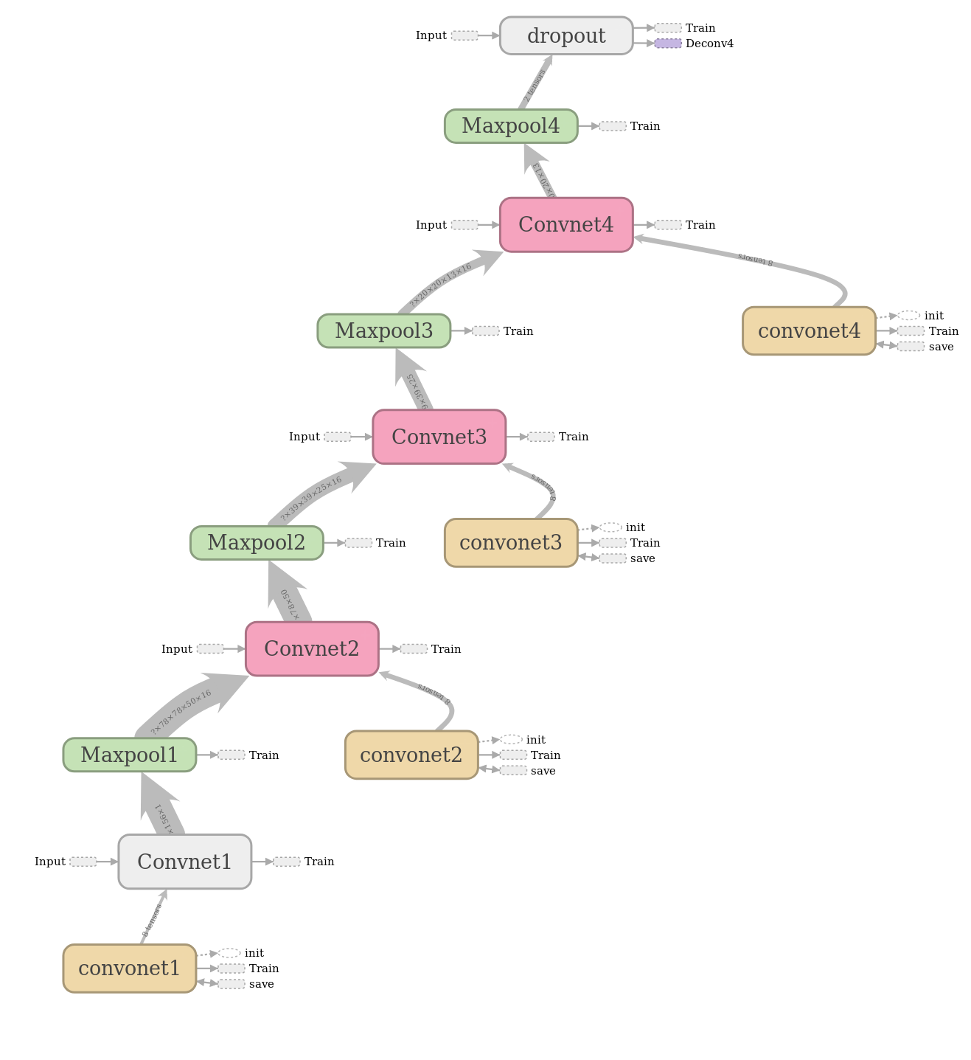
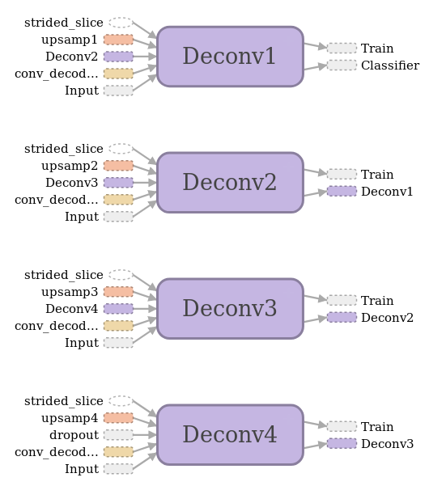
Architecture
Notes:
We observe using dropout after all the encoder and de-coder units results in a lower training fit and poorer test per-formance as it is too strong a regulariser on the model. Wefind that dropping out half of the encoder or decoder unitsis the optimal configuration. The best configuration is drop-ping out the deepest half of the encoder and decoder units.
In the lower layers of convolutional networks basic fea-tures are extracted, such as edges and corners [41]. Theseresults show that applying Bayesian weights to these lay-ers does not result in a better performance. We believethis is because these low level features are consistent acrossthe distribution of models because they are better modelledwith deterministic weights. However, the higher level fea-tures that are formed in the deeper layers, such as shape andcontextual relationships, are more effectively modelled withBayesian weights.
Weight = 1/(ln(c+pclass)). Weight is bounded as pclass approaches 0.
skip connections + transposed conv

Slide 27
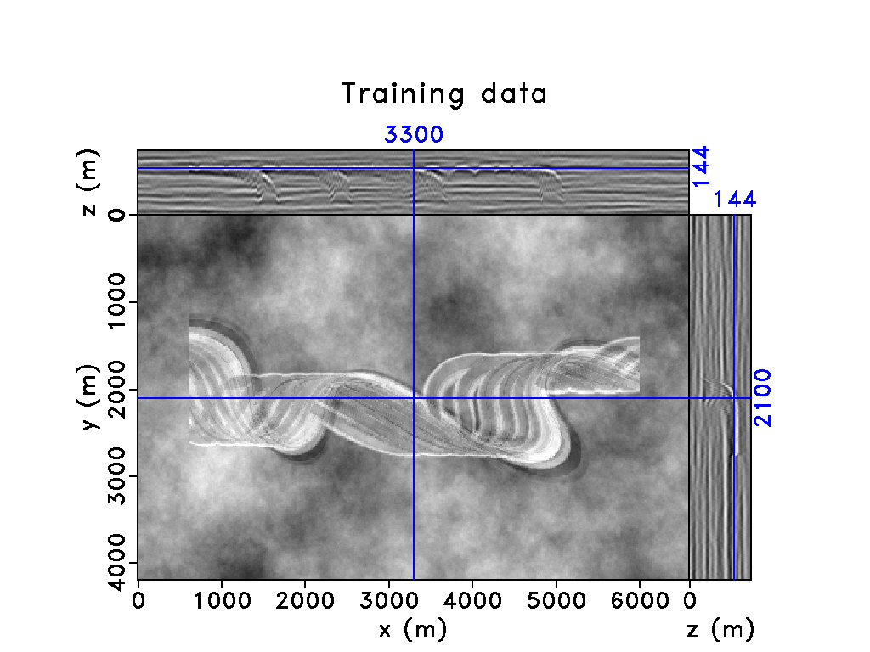
Synthetic dataset
3D synthetic convolutional depth model. Dominant frequency: 40 Hz.
Simulated complex deep-water stacked channel system with correlated noise in porosity.
An overburden with stochastically generated velocity fluctuations on top of the reservoir.

Slide 28
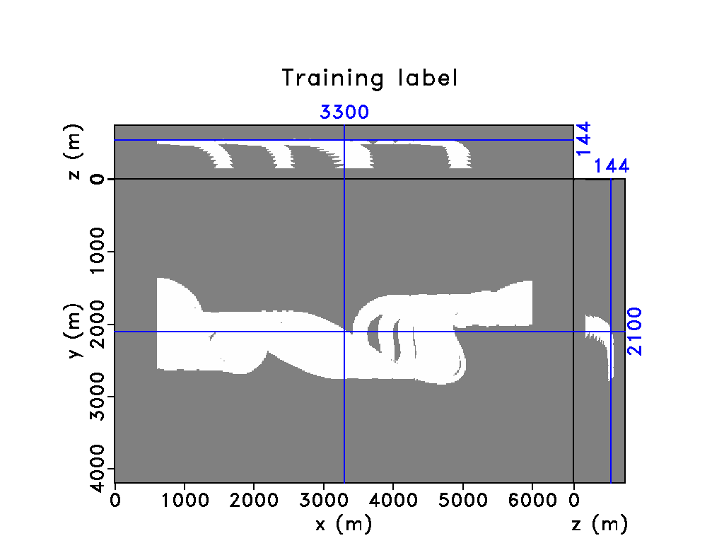
Training dataset and label
Create a mask of 1 where there is channel and 0 everywhere else.
Divide the data and label into small volumes for training.
Pham et al. 2019

Slide 29
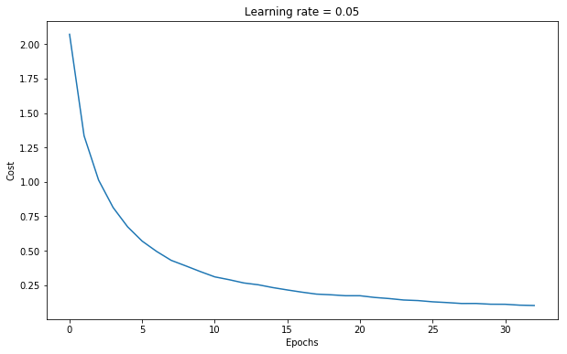
Training loss

Slide 30
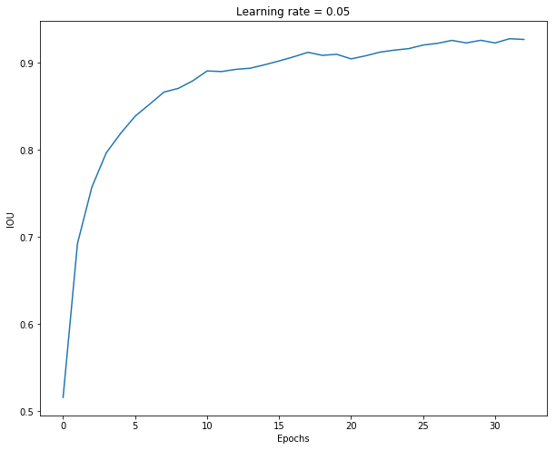

Slide 31
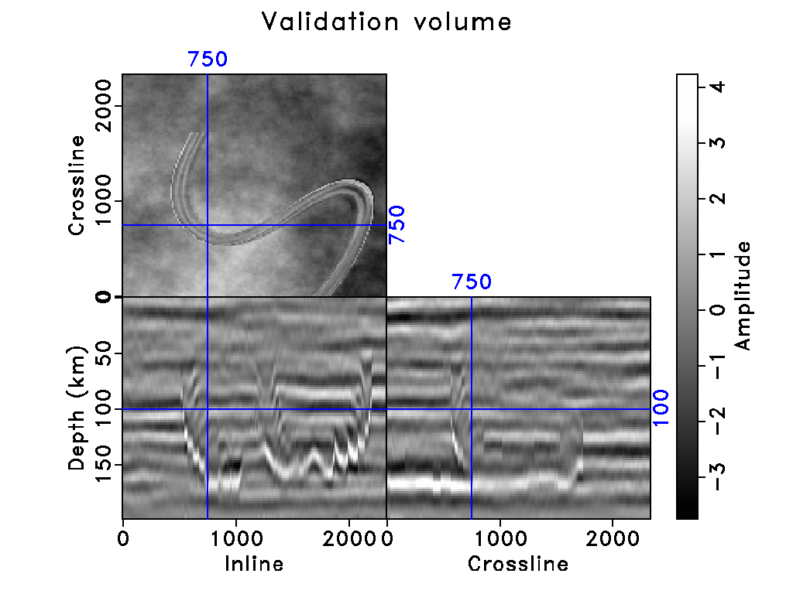
Validation

Slide 32
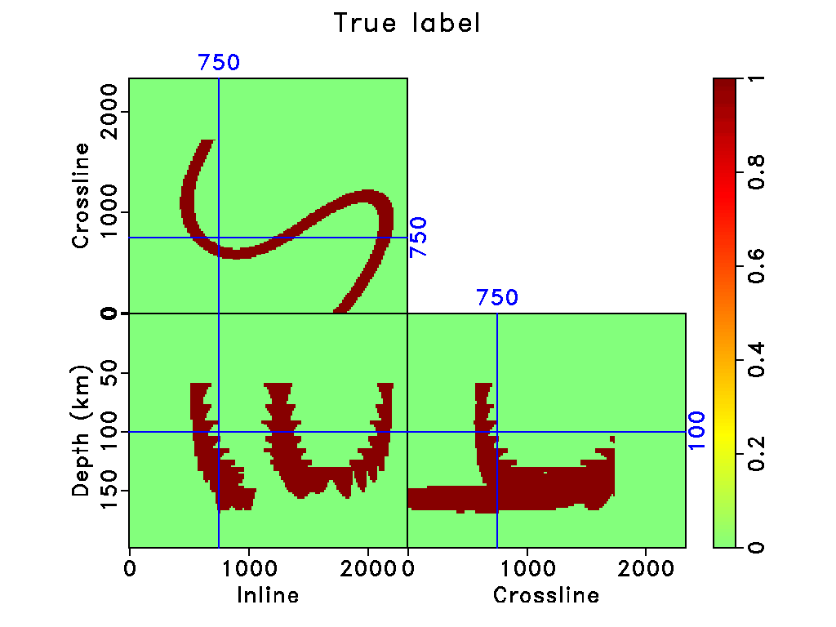
Notes:
Horizontal channels like leeve

Slide 33
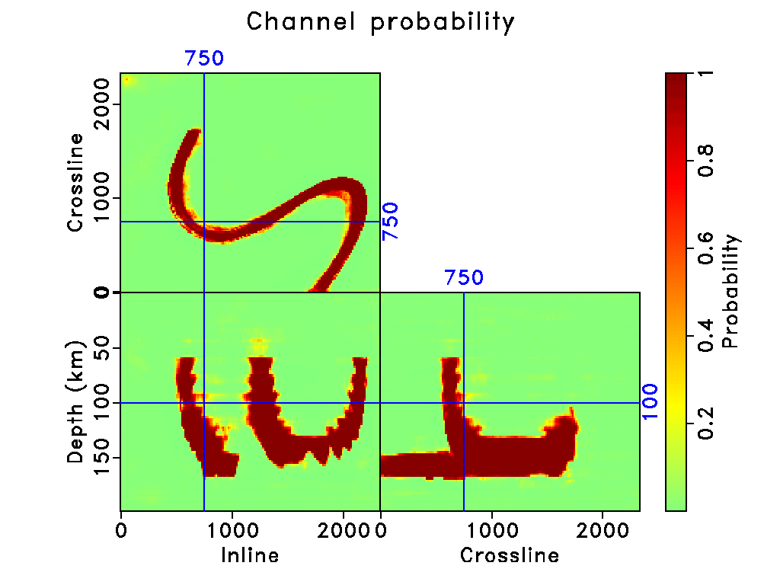

Slide 34
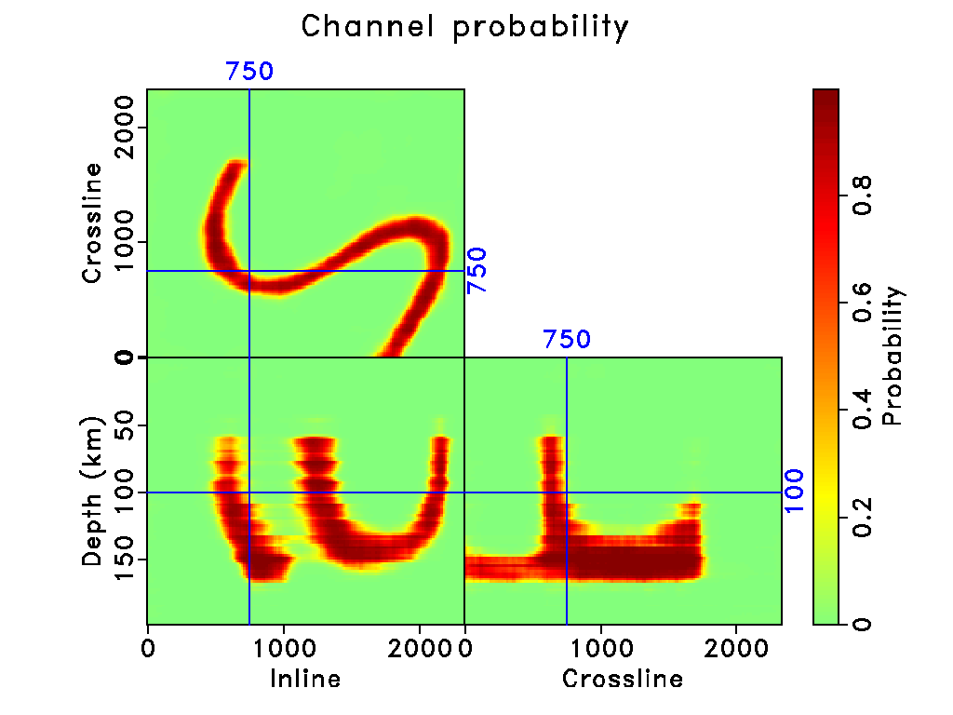
Previous
result
Pham et al. 2019

Slide 35
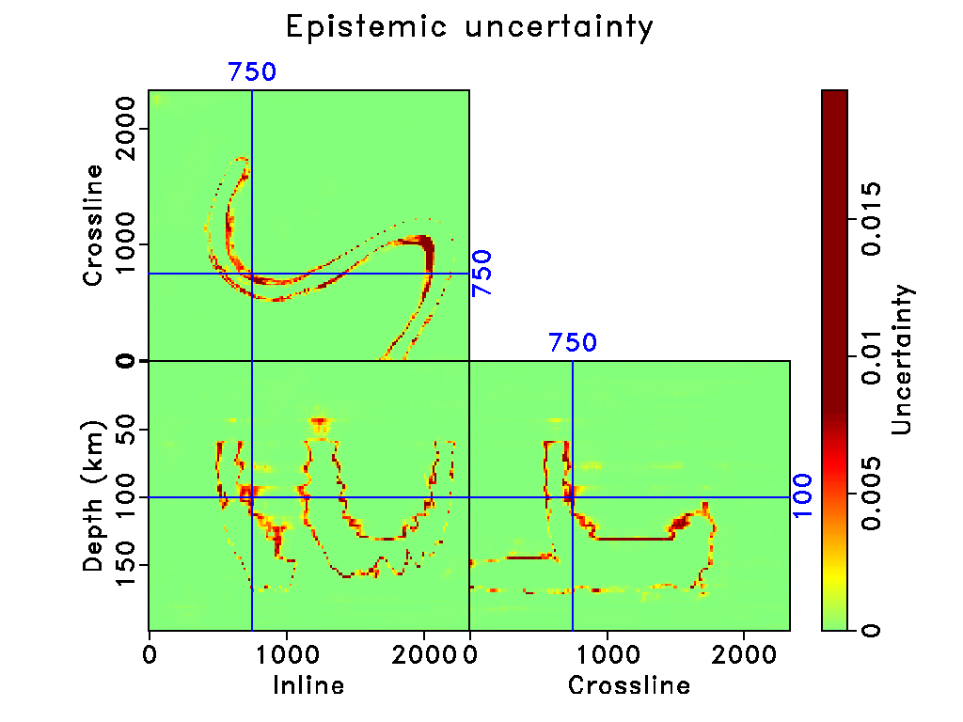

Slide 36
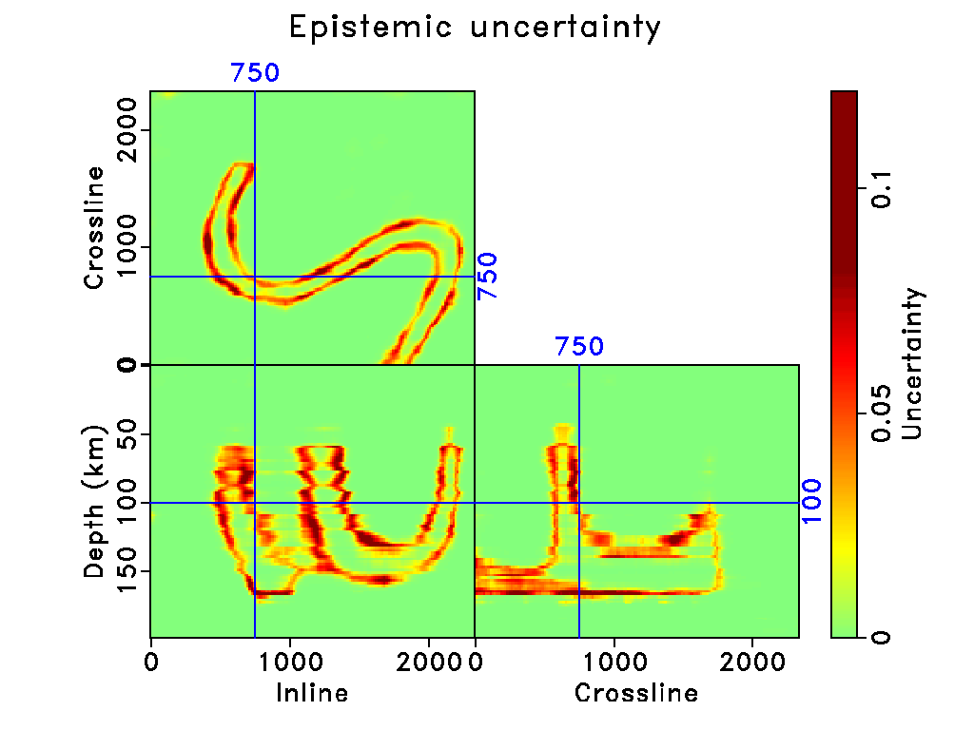
Previous
result
Pham et al. 2019

Slide 37
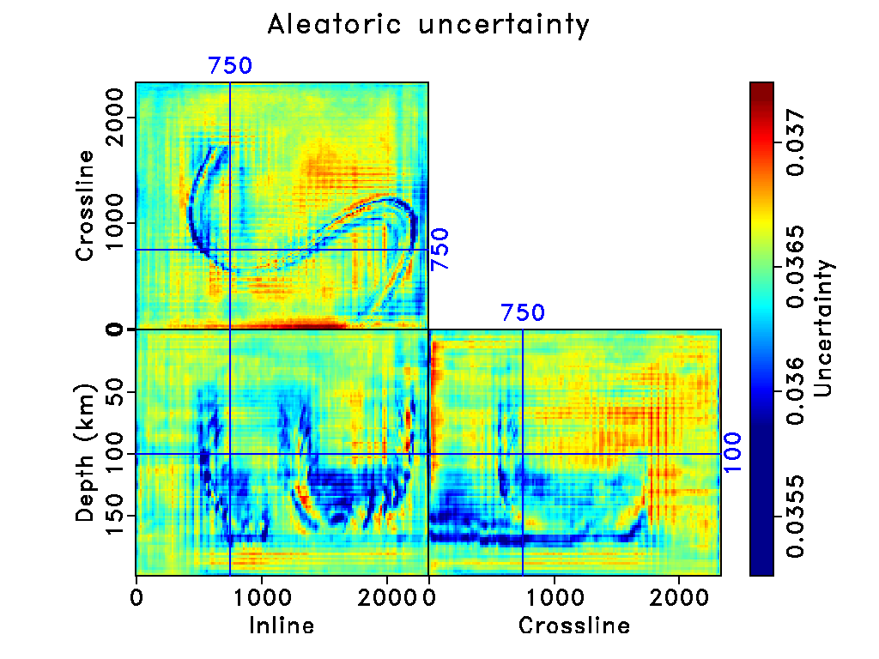

Slide 38
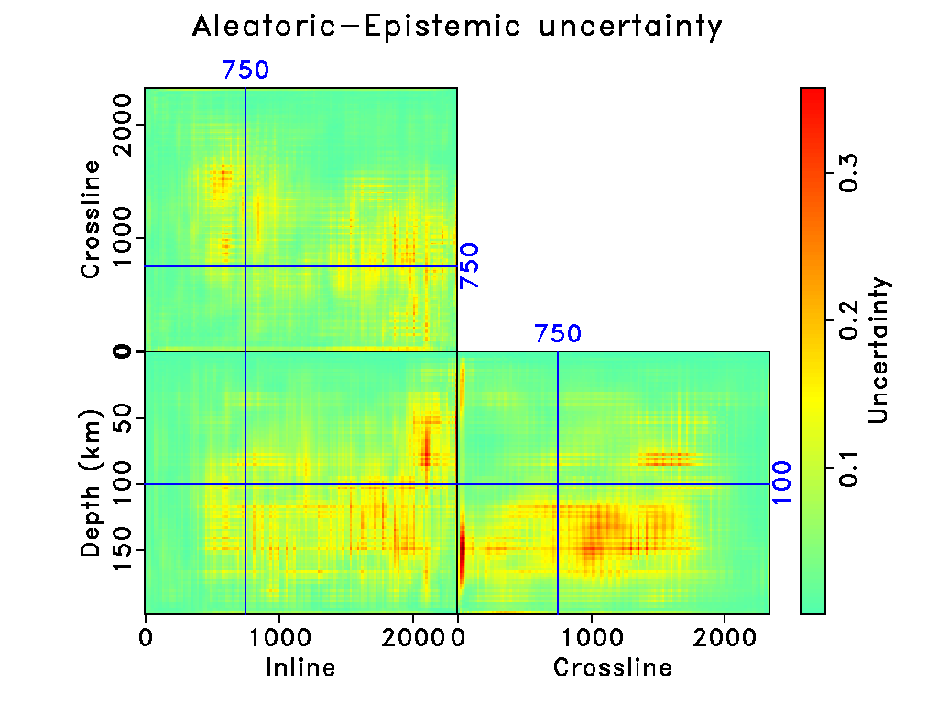
1e-7

Slide 39
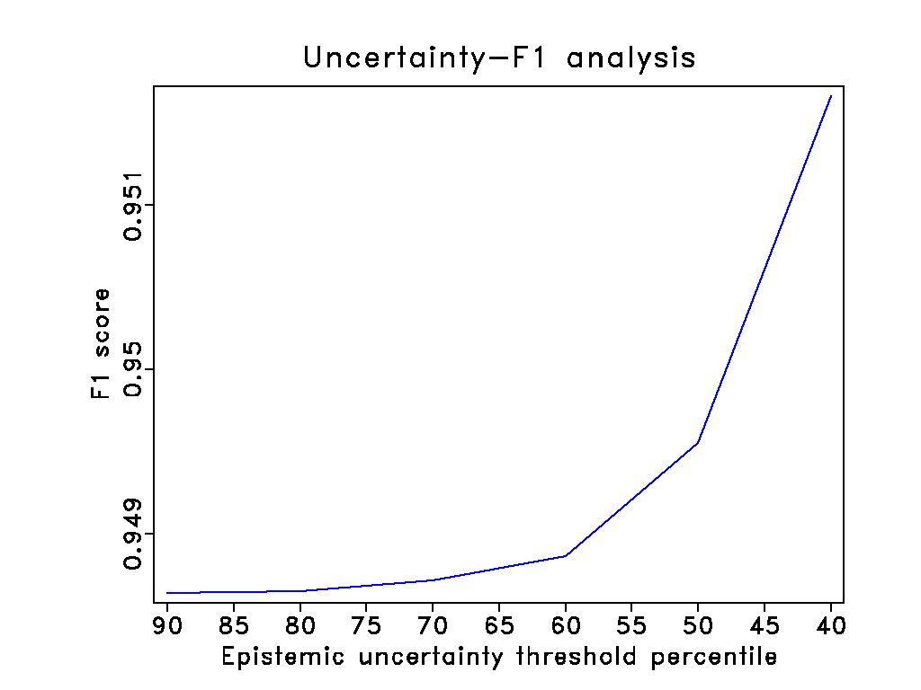
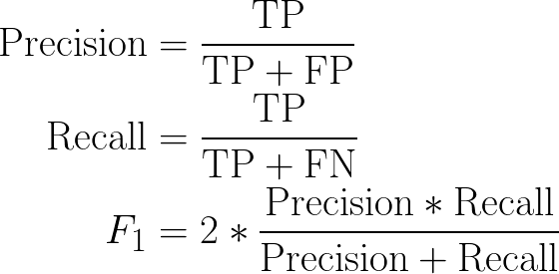

Slide 40
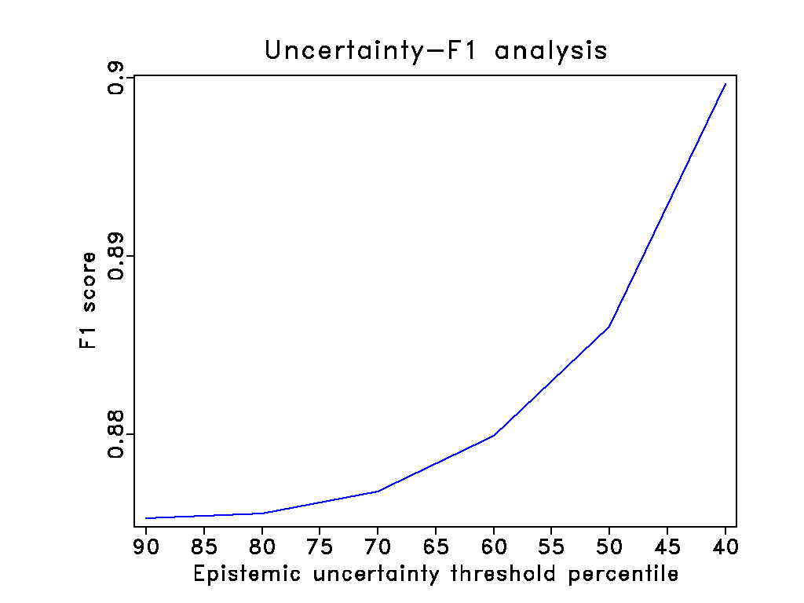
Previous
result
Pham et al. 2019

Slide 41
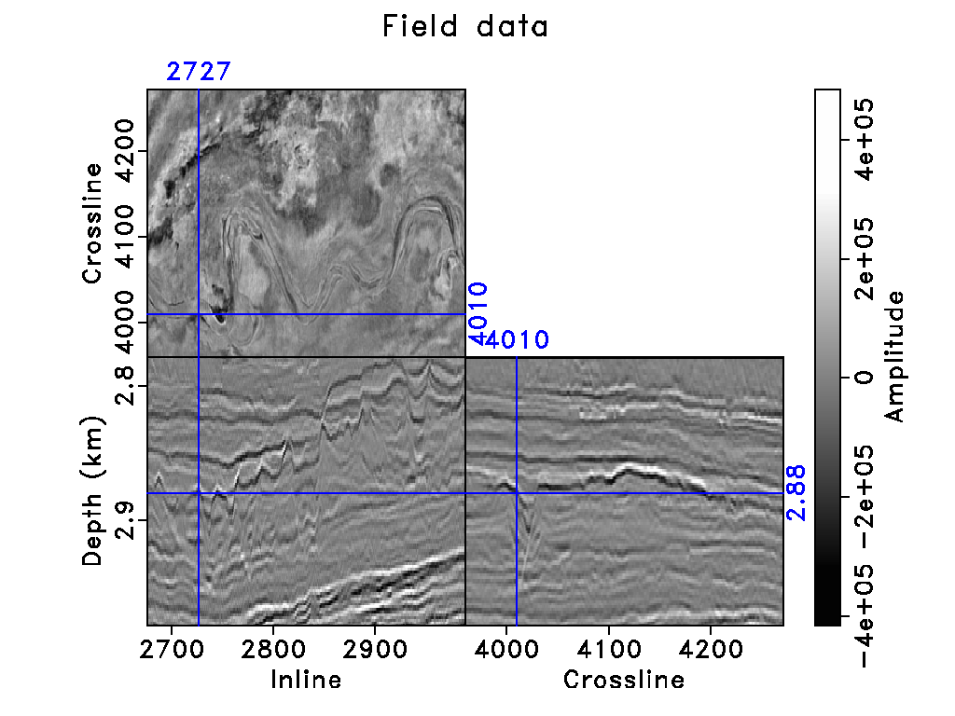
Field data
Notes:
Offshore Aus
120 Hz
Browse basin

Slide 42

Phillip et al. 2017

Slide 43


Slide 44

Previous
result
Pham et al. 2019
Notes:
Thin and multiple channels

Slide 45

Fomel 2010

Slide 46


Slide 47


Slide 48

Previous
result
Notes:
Higher epistemic uncert

Slide 49


Slide 50

1e-7

Slide 51

Notes:
Parihaka

Slide 52


Slide 53


Slide 54


Slide 55


Slide 56


Slide 57

1e-7

Slide 58
Conclusion 1
Modeling epistemic uncertainty by using dropout layer at inference time.
Modeling aleatoric uncertainty by introducing a noise parameter as a regularizer.
Understanding relationships between model mispicks, effects of lacking training data, seismic noisy areas, and uncertainties.

Slide 59


Future work 1
Creating further steps utilizing uncertainties (Wang et al. 2019).
Optimizing the dropout probabilities (Gal et al. 2017).
Using different methods to estimate aleatoric uncertainty (Kohl et al. 2019).
Notes:
Use various annotations to calculate ground truth aleatoric uncertainty
Compare the mean of draw samples with the mean of various annotations and include in the loss using cross entropy.

Slide 60
Model Interpretability

Slide 61

Intermediate layers visualization

Slide 62


Slide 63

Notes:
convdecode1

Slide 64


Slide 65
Saliency map
Visualization of an image in which the most salient/most important pixels are highlighted, based on computing the gradient of the class score with respect to the input image.
To query an already-trained classification CNN about the spatial support of a particular class in a particular image.
Notes:
it does not give any insights on why a neural network makes a specific decision. The next few methods are ways to visualize what part of the input is influencing the output value.

Slide 66

Linear case
The magnitude of elements of w defines the importance of the corresponding pixels of I for the class c.

Slide 67

Non-linear case (CNN)
The magnitude of derivative indicates which pixels need to be changed the least to affect the class score the most -> object location.
Notes:
However in the actual implementation of saliency maps, it does not appear that the calculated output of the CNN, f(a), is used at all

Slide 68

Notes:
The magnitude per pixel, taking the maximum magnitude over the three color channels, as in [2], Section 3.1
The positive magnitudes (positively correlated with the output), keeping color information
The negative magnitudes (negatively correlated with the output), keeping color information

Slide 69


Slide 70
Gradient-weighted Class Activation Mapping
Use gradients of any target concept flowing into the final layer.
Produce a coarse localization map highlighting the important regions for prediction.

Slide 71

Grad-CAM
The weight represents a partial linearization of the network downstream from A, and captures the importance of feature map k.
Interested in the features that have a positive influence on the class c.

Slide 72

Global->Local
Notes:
How spatial attention of a network over an input seismic volume develops might provide clues about the overall strategy the network uses to localize and segment an object
Grad-CAM provides the region of interest on an input image which has a maximum impact on predicting a specific class.
Segmentation is a localization problem but see how attention changes over internal layers of the network, determine how spatial information flows in the model.
Top-down nature. The global-to-local nature of visual percention -> Globaal Precedence Effect

Slide 73


Slide 74

No skip
Notes:
No skip
While skip connections allow upsampling layers to
keep fine-grained features from encoder layers, Natekar et al.
(2020) suggest that they also help encoder layers learn spatial
information earlier.

Slide 75


Slide 76


Slide 77


Slide 78


Slide 79


Slide 80

TranspConv
Odena et al. 2016

Slide 81


Slide 82


Slide 83


Slide 84
Conclusion 2
Using gradients propagating from outputs to different feature maps in the network’s layer to understand the strategy and different components of model.
Network strategy: Global -> Local.

Slide 85

Dorman
Notes:
Applying softmax cross entropy to the distorted logit values is the same as sampling along the line in Figure 1 for a 'logit difference' value.
increasing the variance should only increase the loss. increasing the 'logit difference' results in only a slightly smaller decrease in softmax categorical cross entropy compared to an equal decrease in 'logit difference'. The minimum loss should be close to 0 in this case.
When the 'logit difference' is -4, the softmax cross entropy is 4. The slope on this part of the graph is ~ -1 so this should be true as the 'logit difference' continues to decrease.
To enable the model to learn aleatoric uncertainty, when the 'wrong' logit value is greater than the 'right' logit value (the left half of graph), the loss function should be minimized for a variance value greater than 0. For an image that has high aleatoric uncertainty (i.e. it is difficult for the model to make an accurate prediction on this image), this feature encourages the model to find a local loss minimum during training by increasing its predicted variance.
Loss attenuation
I was able to use the loss function suggested in the paper to decrease the loss when the 'wrong' logit value is greater than the 'right' logit value by increasing the variance, but the decrease in loss due to increasing the variance was extremely small (<0.1). During training, my model had a hard time picking up on this slight local minimum and the aleatoric variance predictions from my model did not make sense. I believe this happens because the slope of Figure 1 on the left half of the graph is ~ -1. Sampling a normal distribution along a line with a slope of -1 will result in another normal distribution and the mean will be about the same as it was before but what we want is for the mean of the T samples to decrease as the variance increases.

Slide 86

Dorman

Slide 87

Right < Wrong
Mean of loss change
Variance

Slide 88

Right > Wrong
Mean of loss change
Variance

Slide 89


